Slide 1

Database Management System Subject Code: 3130703
Prof. Amit Vyas
Department of Computer Engineering
V.V.P. Engineering College

Slide 2
Relational query languages:

Slide 3
Introduction of RELATIONAL ALGEBRA …
RELATIONAL ALGEBRA is a widely used procedural query language.
RELATIONAL ALGEBRA is a language for expressing relation database queries.

Slide 4
Relational Algebra divided in various groups
Unary Relational Operations
SELECT (symbol: σ)
PROJECT (symbol: π)
RENAME (symbol: ρ)
Relational Algebra Operations From Set Theory
UNION (υ)
INTERSECTION (∩)
DIFFERENCE (-)
CARTESIAN PRODUCT ( x )
Binary Relational Operations
JOIN
DIVISION

Slide 5
Selection Operator
Symbol: σ (Sigma)
Notation: σ _{condition} (Relation)
Operation: Selects tuples from a relation that satisfy a given condition.
Operators: =, <>, <, >, <=, >=, Λ (AND), V (OR)

Slide 6
Display the detail of students who belongs to “CE” Branch.
Student
RollNo | Name | Branch | SPI
101 | Raju | CE | 8
102 | Mitesh | ME | 9
103 | Nilesh | Cl | 9
104 | Meet | CE | 9

Slide 7
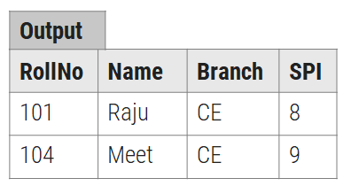
σ_{Branch=‘CE’} (Student)

Slide 8
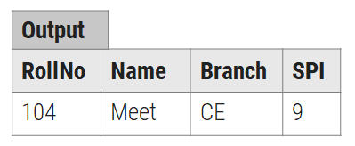
Display the detail of students who belongs to “CE” Branch and having SPI more than 8.
σ_{Branch=‘CE’ Λ SPI>8} (Student)

Slide 9
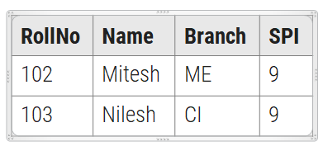
Display the detail of students who belongs to either “CI” or “ME” Branch.
σ_{Branch=‘Cl’ V Branch=‘ME’} (Student)
Output

Slide 10
Display the detail of students those SPI between 7 and 9.
σ_{SPI>7 Λ SPI<9} (Student)
Output
RollNo | Name | Branch | SPI
101 | Raju | CE | 8

Slide 11
Relational Algebra Operations Projection Operator

Slide 12
Projection Operator
Symbol: ∏ (Pi)
Notation: ∏ _{attribute set} (Relation)
Operation: Selects specified attributes of a relation.
It removes duplicate tuples (records) from the result.

Slide 13
Display RollNo, Name and Branch of all students.
∏ _{RollNo, Name, Branch} (Student)
Output
RollNo | Name | Branch
101 | Raju | CE
102 | Mitesh | ME
103 | Nilesh | Cl
104 | Meet | CE

Slide 14
Display Name and SPI of all students.
∏ _{Name, SPI} (Student)
Name | SPI
Raju | 8
Mitesh | 9
Nilesh | 9
Meet | 9

Slide 15
Combined Projection & Selection Operation
Student
Roll.No | Name | Branch | SPI
101 | Raju | CE | 8
102 | Mitesh | ME | 9
103 | Nilesh | Cl | 9
104 | Meet | CE | 7

Slide 16
Display RollNo, Name, Branch and Branch =“ME” students.
σ_{Branch=‘ME’} (Student)
∏ _{RollNo, Name, Branch} (σ_{Branch=‘ME’} (Student))
Roll.No | Name | Branch | SPI
102 | Mitesh | ME | 9
Roll.No | Name | Branch
102 | Mitesh | ME

Slide 17
Display Name, Branch and SPI of students whose SPI is more than 8.
σ_{SPI>8} (Student) ∏ _{Name, Branch, SPI} (σ_{SPI>8} (Student))
Name | Branch | SPI
Mitesh | ME | 9
Nilesh | Cl | 9
Roll.No | Name | Branch | SPI
102 | Mitesh | ME | 9
103 | Nilesh | Cl | 9

Slide 18
Display Name, Branch and SPI of students who belongs to “CE” Branch and SPI is more than 7.
σ_{Branch=‘CE’ Λ SPI>7} (Student)
RollNo | Name | Branch | SPI
101 | Raju | CE | 8

Slide 19
Display Name, Branch and SPI of students who belongs to “CE” Branch and SPI is more than 7.
∏ _{Name, Branch, SPI} (σ_{Branch=‘CE’ Λ SPI>7} (Student))
Name | Branch | SPI
Raju | CE | 8

Slide 20
Display Name of students along with their Branch who belong to either “ME” Branch or “CI” Branch.
σ_{Branch=‘ME’ V Branch=‘CI’} (Student)
RollNo | Name | Branch | SPI
102 | Mitesh | ME | 9
103 | Nilesh | Cl | 9

Slide 21
Display Name of students along with their Branch who belong to either “ME” Branch or “CI” Branch.
∏ _{Name, Branch} (σ_{Branch=‘ME’ V Branch=‘CI’} (Student))
Name | Branch
Mitesh | ME
Nilesh | Cl

Slide 22
Rename Operator
Symbol: ρ (Rho)
Notation: ρ_{A (X1,X2….Xn)} (Relation)
Operation:
The rename operation is used to rename the output relation.
The result of rename operator are also relations with new name.
The original relation name can not be changed when we perform rename operation on any relation.
ρ _{A1, A2. …,An} (E)
Returns a relation E with the attributes renamed to A1, A2, …., An.

Slide 23
Rename table
Student
RNo | Name | CPI
101 | Raj | 8
102 | Meet | 9
103 | Jay | 7

Slide 24
Person
ρ_{Person} (Student)
RNo | Name | CPI
101 | Raj | 8
102 | Meet | 9
103 | Jay | 7

Slide 25
ρ_{(RollNo, StudentName, CPI)} (Student)
RNo | Student Name | CPI
101 | Raj | 8
102 | Meet | 9
103 | Jay | 7

Slide 26
Rename table and attributes both
student
RNo | Student Name | CPI
101 | Raj | 8
102 | Meet | 9
103 | Jay | 7

Slide 27
ρ_{Person (RollNo, StudentName)} (∏ _{RNo, Name} (Student))
Person
RollNo | StudentName
101 | Raj
102 | Meet
103 | Jay

Slide 28
Aggregate Functions
RNo | Student Name | CPI
101 | Raj | 8
102 | Meet | 9
103 | Jay | 7

Slide 29
Find out sum of CPI of all students.
g _{sum(CPI)} (Student)
Find out maximum & minimum CPI.
g _{max(CPI), min(CPI)} (Student)
sum
24
max | min
9 | 7

Slide 30
Count the number of students.
g _{count(Rno)} (Student)
Find out average of CPI of all students.
g _{avg(CPI)} (Student)
Count
3
Avg
8

Slide 31
Types of set

Slide 32
Union Operator
Symbol: U
Notation: Relation-1 (R1) U Relation-2 (R2) OR Algebra-1 U Algebra-2
Customer Employee Customer U Employee
Amit
Dip
Jay
Meet
Jay
Manoj
Amit
Dip
Jay
Meet
Manoj

Slide 33
Intersect/ Intersection Operator
Symbol: ∩
Notation: Relation-1 (R1) ∩ Relation-2 (R2) OR Algebra-1 ∩ Algebra-2
It displays all the tuples/records which are common from both relations.
Customer Employee Customer ∩ Employee
Amit
Dip
Jay
Amit
Punit
Jay
Amit
Jay

Slide 34
Minus/ Set difference Operator
Symbol: −
Notation: Relation-1 (R1) − Relation-2 (R2) OR Algebra-1 − Algebra-2
Customer Employee Customer –Employee Employee − Customer
-
Amit
Dip
Meet
Meet
Dip
Jay
Amit
Jay

Slide 35
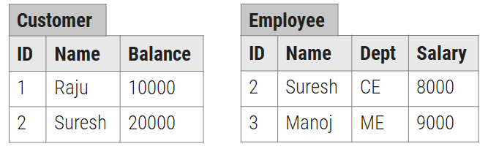
Union Operators Example
Display Name of person who are either employee or customer.
∏ _{Name} (Customer) U ∏ _{Name} (Employee)
Raju
Suresh
Manoj

Slide 36
Intersect/ Intersection Operators Example
Display Name of person who are employee as well as customer.
∏ _{Name} (Customer) ∩ ∏ _{Name} (Employee)
Suresh

Slide 37
Minus/ Set difference Operators Example
Display Name of person who are employee but not customer.
∏ _{Name} (Employee) - ∏ _{Name} (Customer)
Manoj

Slide 38
Cartesian Product(✕)
Notation: S ✕ R where A and S are the relations, the symbol ‘✕’ is used to denote the CROSS PRODUCT operator. Consider two relations STUDENT(Sr.No., First Name, Last Name) and DETAIL(RollNo, Age) below:
Sr.No. | First Name | Last Name
1 | Amit | Vyas
2 | Punit | Patel
RollNo | Age
5 | 25
9 | 28

Slide 39
output
Sr.No | First Name | Last Name | RollNo | Age
1 | Amit | Vyas | 5 | 25
1 | Amit | Vyas | 9 | 28
2 | Punit | Patel | 5 | 25
2 | Punit | Patel | 9 | 28

Slide 40
Division Operator
Symbol: ÷ (Division)
Notation: Relation1 (R1) ÷ Relation2 (R2) OR Algebra1 ÷ Algebra2

Slide 41
Relational Algebra Operations Division Operator
STUDENT SUBJECT (STUDENT/ SUBJECT)
NAME | SUBJECT
AMIT | DBMS
AMIT | DS
DIP | DS
DIP | DBMS
ROHIT | DS
Name
ROHIT
Name
DBMS
SUBJECT
DBMS
DS

Slide 42
Relational Algebra Operations Natural Join / Inner Join

Slide 43
Write down relational algebra for the following tables/relations
Student (Rno, Sname, Address, City, Mobile)
Department (Did, Dname)
Academic (Rno, Did, SPI, CPI, Backlog)
Guide (Rno, PName, Fid)
Faculty (Fid, Fname, Subject, Did, Salary)
List the name of students with their department name and SPI of all student belong to “CE” department.
∏ _{Sname, Dname, SPI} (σ_{Dname=‘CE’} (Student (Department Academic)))

Slide 44
Display the name of students with their project name whose guide is “ A.J.Shah”.
∏ _{Sname, Pname}(σ_{Fname=‘A.J.Shah’} (Student (Guide Faculty)))

Slide 45
Consider following schema and represent given statements in relation algebra form.
Branch(branch_name,branch_city)
Account(branch_name, acc_no, balance)
Depositor(customer_name, acc_no)

Slide 46
Find out list of customer who have account at ‘abc’ branch.
∏ _{customer_name}(σ _{branch_name=‘abc’} (Depositor ⋈ Account))

Slide 47
Find out all customer who have an account in ‘Ahmedabad’ city and balance is greater than 10,000.
∏ _{customer_name}(σ _{branch.} _{Branch_city= ‘Ahmedabad’} Λ σ _{account.balance>10000} (Branch ⋈ Account ⋈ Depositor))

Slide 48
find out list of all branch name with their maximum balance.
∏ _{branch_name} G _{max (balance)} (Account)

Slide 49
Open Source | Commercial DBMS
DBMS, which is available in the market at free of cost. | DBMS, which is available in the market at a certain price.
The code of open source DBMS product can be viewed, shared or modified by the community. | The code of commercial DBMS product can not be view, share or modify by the community.
There are chances of malfunctioning with code as source code is open. | The security is high and code is not accessible to unauthorized person.
Examples: MySQL, MongoDB, SQLite etc | Examples: Microsoft SQL Server, IBM Db2 etc

Slide 50
Thank You

